Slide 1
Graphical User Interface in Java

Slide 2
Graphical User Interface
In Java, GUI-based programs are implemented by using classes from the javax.swing and java.awt packages.
The Swing classes provide greater compatibility across different operating systems. They are fully implemented in Java, and behave the same on different operating systems.
Notes:
Classes we use to develop GUI-based programs are located in two packages javax.swing and java.awt. Many of the classes in the java.awt package are replaced by Swing counterparts, and for the most part, using the Swing classes over the AWT classes is the preferred approach because the newer Swing classes are better implementation. We still have to refer to java.awt package because there are some classes that are defined only in the java.awt package.

Slide 3
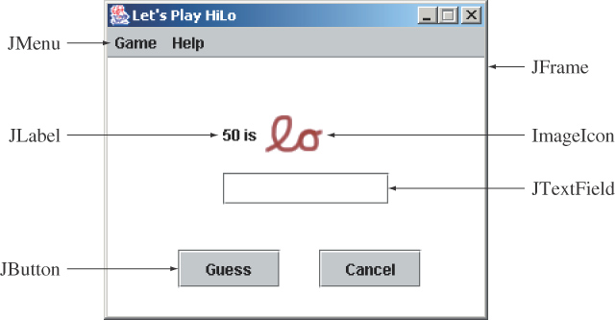
Sample GUI Objects
Various GUI objects from the javax.swing package.
Notes:
Here's a sample frame that includes a number of common Swing components. We will see examples using JFrame and JButton in this lesson. We will see other components in the later lessons of this module.

Slide 4
Subclassing JFrame
To create a customized frame window, we define a subclass of the JFrame class.
The JFrame class contains rudimentary functionalities to support features found in any frame window.
Notes:
The standard JFrame class includes only most basic functionalities. When we need a frame window in our application, it is typical for us to define a subclass of JFrame to create a frame window that is customized to our needs. We will study the basics of this customization.

Slide 5
Creating a Subclass of JFrame
To define a subclass of another class, we declare the subclass with the reserved word extends.
import javax.swing.*;
class MyJFrame extends JFrame {
. . .
}
Notes:
A subclass of any class is declared by including the keyword 'extends' the class definition header. The example here defines a subclass of JFrame named Ch7JFrameSubclass1.

Slide 6
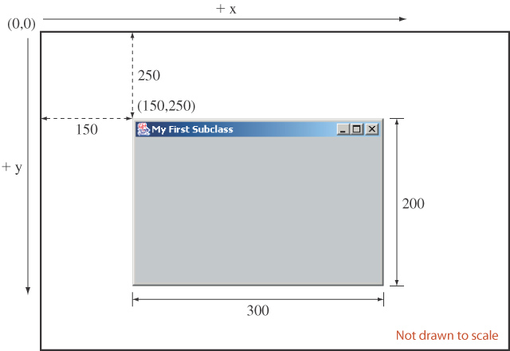
Example
Notes:
This diagram illustrates how the arguments to the setSize and setLocation methods affect the frame window appearance on the screen. The top left corner of the screen has coordinate (0,0). The value of x increases as you move toward right and the value of y increases as you move down. Notice that the screen coordinate is different from the coordinate system of a mathematical 2-D graph.

Slide 7
Code
import javax.swing.*;
public class JFrameSubclass extends JFrame {
private static final int FRAME_WIDTH=300;
private static final int FRAME_HEIGHT=200;
private static final int FRAME_X_ORIGIN=150;
private static final int FRAME_Y_ORIGIN = 250;
public JFrameSubclass () {
setTitle("My First Subclass");
setSize(FRAME_WIDTH, FRAME_HEIGHT);
setLocation(FRAME_X_ORIGIN, FRAME_Y_ORIGIN);
setDefaultCloseOperation(EXIT_ON_CLOSE);
}
}
Import GUI swing package

Slide 8
Code
Create a subclass that inherits JFrame class
import javax.swing.*;
public class JFrameSubclass extends JFrame {
private static final int FRAME_WIDTH=300;
private static final int FRAME_HEIGHT=200;
private static final int FRAME_X_ORIGIN=150;
private static final int FRAME_Y_ORIGIN = 250;
public JFrameSubclass () {
setTitle("My First Subclass");
setSize(FRAME_WIDTH, FRAME_HEIGHT);
setLocation(FRAME_X_ORIGIN, FRAME_Y_ORIGIN);
setDefaultCloseOperation(EXIT_ON_CLOSE);
}
}

Slide 9
JFrame class
Type: “JFrame class Java” in Google and choose the link:
http://java.sun.com/j2se/1.4.2/docs/api/javax/swing/JFrame.html

Slide 10
Code
Constant declarations
import javax.swing.*;
public class JFrameSubclass extends JFrame {
private static final int FRAME_WIDTH=300;
private static final int FRAME_HEIGHT=200;
private static final int FRAME_X_ORIGIN=150;
private static final int FRAME_Y_ORIGIN = 250;
public JFrameSubclass () {
setTitle("My First Subclass");
setSize(FRAME_WIDTH, FRAME_HEIGHT);
setLocation(FRAME_X_ORIGIN, FRAME_Y_ORIGIN);
setDefaultCloseOperation(EXIT_ON_CLOSE);
}
}

Slide 11
Code
Constructor for this JFrameSubclass class
import javax.swing.*;
public class JFrameSubclass extends JFrame {
private static final int FRAME_WIDTH=300;
private static final int FRAME_HEIGHT=200;
private static final int FRAME_X_ORIGIN=150;
private static final int FRAME_Y_ORIGIN = 250;
public JFrameSubclass () {
setTitle("My First Subclass");
setSize(FRAME_WIDTH, FRAME_HEIGHT);
setLocation(FRAME_X_ORIGIN, FRAME_Y_ORIGIN);
setDefaultCloseOperation(EXIT_ON_CLOSE);
}
}

Slide 12
Using methods from JFrame class
setTitle methods:
Description is available at:
http://java.sun.com/j2se/1.4.2/docs/api/java/awt/Frame.html#setTitle(java.lang.String)
setTitle
public void setTitle(String title)
  Sets the title for this frame to the specified string.
Example:
setTitle("My First Subclass”);

Slide 13
Using methods in JFrame
setSize(int, int)
Avaiable at:
http://java.sun.com/j2se/1.4.2/docs/api/java/awt/Component.html#setSize(int,%20int)
public void setSize(int width, int height)
  Resizes this component so that it has width width and height height.
Example:
setSize(FRAME_WIDTH, FRAME_HEIGHT);

Slide 14
Using methods in JFrame
setLocation http://java.sun.com/j2se/1.4.2/docs/api/java/awt/Component.html#setLocation(int,%20int)
public void setLocation(int x, int y)
Moves this component to a new location. The top-left corner of the new location is specified by the x and y parameters in the coordinate space of this component's parent.
Example: setLocation(FRAME_X_ORIGIN, FRAME_Y_ORIGIN);

Slide 15
Using methods in JFrame
setDefaultCloseOperation: http://java.sun.com/j2se/1.4.2/docs/api/javax/swing/JFrame.html#setDefaultCloseOperation(int)
public void setDefaultCloseOperation(int operation)
Example: setDefaultCloseOperation(EXIT_ON_CLOSE);

Slide 16
Using public constants in JFrame
EXIT_ON_CLOSE
http://java.sun.com/j2se/1.4.2/docs/api/javax/swing/JFrame.html#EXIT_ON_CLOSE
public static final int EXIT_ON_CLOSE

Slide 17
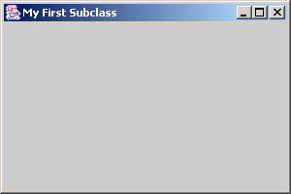
The Content Pane of a Frame
The content pane is where we put GUI objects such as buttons, labels, scroll bars, and others.
We access the content pane by calling the frame’s getContentPane method.
This gray area is the content pane of this frame.
Notes:
A frame window is composed of four borders, a title bar, and a content area. The content area is called a content pane in Java, and this is the area we can use to place GUI components.

Slide 18
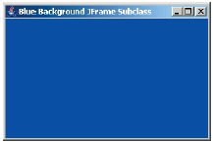
Changing the Background Color
Here's how we can change the background color of a content pane to blue:
Container contentPane = getContentPane();
contentPane.setBackground(Color.BLUE);
Notes:
We access the content pane of a frame by calling the JFrame method called getContentPane. We declare the data type for the object returned by the getContentPane method to Container. Once we get the content pane object, we can call its methods. The example here calls the setBackground method to change the default background color of gray to white. The complete sample code can be found in the file Ch7JFrameSubclass2.java.

Slide 19
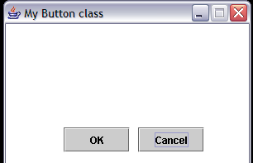
Adding event-handling

Slide 20
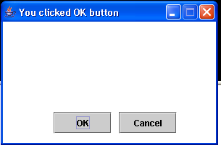
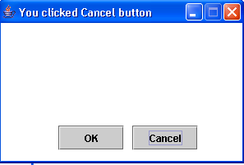
Example

Slide 21
Create a button
Create a dumb GUI first
Add a module to handle event later

Slide 22
Create a dumb GUI

Slide 23
Code
import javax.swing.*;
import java.awt.*;
import java.awt.event.*;
public class JButtonFrame extends JFrame {
private static final int FRAME_WIDTH=300;
private static final int FRAME_HEIGHT=200;
private static final int FRAME_X_ORIGIN=150;
private static final int FRAME_Y_ORIGIN = 250;
private static final int BUTTON_WIDTH=80;
private static final int BUTTON_HEIGHT=30;
private JButton cancelButton;
private JButton okButton;
Packages included for event and GUI objects

Slide 24
Code
import javax.swing.*;
import java.awt.*;
import java.awt.event.*;
public class JButtonFrame extends JFrame {
private static final int FRAME_WIDTH=300;
private static final int FRAME_HEIGHT=200;
private static final int FRAME_X_ORIGIN=150;
private static final int FRAME_Y_ORIGIN = 250;
private static final int BUTTON_WIDTH=80;
private static final int BUTTON_HEIGHT=30;
private JButton cancelButton;
private JButton okButton;

Slide 25
Code
import javax.swing.*;
import java.awt.*;
import java.awt.event.*;
public class JButtonFrame extends JFrame {
private static final int FRAME_WIDTH=300;
private static final int FRAME_HEIGHT=200;
private static final int FRAME_X_ORIGIN=150;
private static final int FRAME_Y_ORIGIN = 250;
private static final int BUTTON_WIDTH=80;
private static final int BUTTON_HEIGHT=30;
private JButton cancelButton;
private JButton okButton;

Slide 26
Code
import javax.swing.*;
import java.awt.*;
import java.awt.event.*;
public class JButtonFrame extends JFrame {
private static final int FRAME_WIDTH=300;
private static final int FRAME_HEIGHT=200;
private static final int FRAME_X_ORIGIN=150;
private static final int FRAME_Y_ORIGIN = 250;
private static final int BUTTON_WIDTH=80;
private static final int BUTTON_HEIGHT=30;
private JButton cancelButton;
private JButton okButton;

Slide 27
Constructor for this class
public JButtonFrame () {
Container contentPane= getContentPane();
setTitle("My Button class");
setResizable(false);
setSize(FRAME_WIDTH, FRAME_HEIGHT);
setLocation(FRAME_X_ORIGIN, FRAME_Y_ORIGIN);
contentPane.setLayout(null);
contentPane.setBackground(Color.white);

Slide 28
Constructor (continue)
okButton = new JButton("OK");
okButton.setBounds(70,125,BUTTON_WIDTH,BUTTON_HEIGHT);
contentPane.add(okButton);
cancelButton = new JButton("Cancel");
cancelButton.setBounds(160,125,BUTTON_WIDTH,BUTTON_HEIGHT);
contentPane.add(cancelButton);
}
}

Slide 29
Event Handling
An action involving a GUI object, such as clicking a button, is called an event.
The mechanism to process events is called event handling.
The event-handling model of Java is based on the concept known as the delegation-based event model.
With this model, event handling is implemented by two types of objects:
  event source objects
  event listener objects
Notes:
JButton and other GUI objects are event source objects. Any object can be designated as event listener objects.

Slide 30
Steps Required to Set Up Event Handling for a GUI Component
Several coding steps are required for an application to respond to events
  Create a class for the event handler
  Implement an appropriate event-listener interface
  Register the event handler

Slide 31
Event Source Objects
An event source is a GUI object where an event occurs. We say an event source generates events.
Buttons, text boxes, list boxes, and menus are common event sources in GUI-based applications.
Although possible, we do not, under normal circumstances, define our own event sources when writing GUI-based applications.
Notes:
A single event source can generate more than one type of events. When an event is generated, a corresponding event listener is notified. Whether there is a designated listener or not, event sources generates events. If there's a no matching listeners, generated events are simply ignored.

Slide 32
Event Listener Objects
An event listener object is an object that includes a method that gets executed in response to the generated events.
A listener must be associated, or registered, to a source, so it can be notified when the source generates events.
Notes:
A listener can listen to a single type of events. If an event source generates two types of events, then we need two different listeners if we want process both types of events. A single listener, however, can be set to listen to single type of events from more than one event source.

Slide 33
Connecting Source and Listener
event source
event listener
notify
JButton
Handler
register
A listener must be registered to a event source. Once
registered, it will get notified when the event source
generates events.
Notes:
This diagram shows the relationship between the event source and listener. First we register a listener to an event source. Once registered, whenever an event is generated, the event source will notify the listener.

Slide 34
Event Types
Registration and notification are specific to event types
    Mouse listener handles mouse events
    Item listener handles item selection events
    and so forth
Among the different types of events, the action event is the most common.
  Clicking on a button generates an action event
  Selecting a menu item generates an action event
  and so forth
Action events are generated by action event sources and handled by action event listeners.
Notes:
There are different types of events. Some event sources generate only one type of events, while others generate three or four different types of events. For example, a button can generate an action event, a change event, and a item event. The most common type of event we are interested in processing for various types of GUI components is the action event.

Slide 35
Handling Action Events
action event
source
action event
listener
actionPerformed
JButton
Button
Handler
addActionListener
JButton button = new JButton("OK");
ButtonHandler handler = new ButtonHandler( );
button.addActionListener(handler);
Notes:
This code shows how we register an action event listener to a button. The object we register as an action listener must be an instance of a class that implements the ActionListener interface. The class must define a method named actionPerformed. This is the method executed in response to the generated action events.

Slide 36
Review
A Java interface is different from a class because it includes only to specify the behavior and does not include data members or
A. Method declarations
B. Implementation
of a method

Slide 37
Review
A Java interface is different from a class because it includes only to specify the behavior and does not include data members or
A
B
Method declarations
B. Implementation
of a method

Slide 38
Code for event-handling
import javax.swing.*;
import java.awt.*;
import java.awt.event.*;
public class ButtonHandler implements ActionListener {
public ButtonHandler() { }
public void actionPerformed(ActionEvent event){
JButton clickedButton=(JButton) event.getSource();
JRootPane rootPane = clickedButton.getRootPane();
JFrame frame =(JFrame) rootPane.getParent();
String buttonText = clickedButton.getText();
frame.setTitle("You clicked "+buttonText+" button");
}
}

Slide 39
Add code to JButtonFrame class
….
ButtonHandler handler = new ButtonHandler();
cancelButton.addActionListener(handler);
okButton.addActionListener(handler);
setDefaultCloseOperation(EXIT_ON_CLOSE);
}
}

Slide 40
Main class
  public class JButtonFrameMain {
  public static void main(String[] args) {
  JButtonFrame frameObj = new JButtonFrame();
  frameObj.setVisible(true);
  }
  }

Slide 41
Practice (in class)
Practice (GUI) (in class)
  Create a frame that contains 3 buttons:
    Spring semester
    Summer
    Fall semester
    Whenever a user click on each button, the title of the frame that changes to “ This is Spring semester”, “This is summer” and “This is Fall semester”

Slide 42
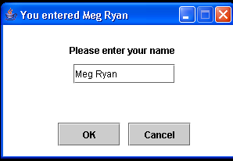
Adding label and text field
Label
Textfield

Slide 43
Code – GUI handler
import javax.swing.*;
import java.awt.*;
import java.awt.event.*;
public class GuiHandler implements ActionListener {
public GuiHandler() { }
public void actionPerformed(ActionEvent event){
if (event.getSource() instanceof JButton) {
JButton clickedButton=(JButton) event.getSource();
JRootPane rootPane = clickedButton.getRootPane();
JFrame frame =(JFrame) rootPane.getParent();
String buttonText = clickedButton.getText();
frame.setTitle("You clicked "+buttonText+" button");
}
else if (event.getSource() instanceof JTextField) {
JTextField inputTextField=(JTextField) event.getSource();
JRootPane rootPane = inputTextField.getRootPane();
JFrame frame =(JFrame) rootPane.getParent();
String inputText = inputTextField.getText();
frame.setTitle("You entered "+inputText);
}
}
}

Slide 44
Code - TextFrame
import javax.swing.*;
import java.awt.*;
import java.awt.event.*;
public class JTextFrame extends JFrame {
private static final int FRAME_WIDTH=300;
private static final int FRAME_HEIGHT=200;
private static final int FRAME_X_ORIGIN=150;
private static final int FRAME_Y_ORIGIN = 250;
private static final int BUTTON_WIDTH=80;
private static final int BUTTON_HEIGHT=30;
private JButton cancelButton;
private JButton okButton;
private JLabel prompt;
private JTextField inputLine;

Slide 45
Code
public JTextFrame () {
Container contentPane= getContentPane();
setTitle("My Button class");
setResizable(false);
setSize(FRAME_WIDTH, FRAME_HEIGHT);
setLocation(FRAME_X_ORIGIN, FRAME_Y_ORIGIN);
contentPane.setLayout(null);
contentPane.setBackground(Color.white);
GuiHandler handler = new GuiHandler();

Slide 46
Code
prompt = new JLabel();
prompt.setText("Please enter your name");
prompt.setBounds(85,20,150,25);
contentPane.add(prompt);
inputLine = new JTextField();
inputLine.setBounds(90,50,130,25);
contentPane.add(inputLine);
inputLine.addActionListener(handler);

Slide 47
Code
okButton = new JButton("OK");
okButton.setBounds(70,125,BUTTON_WIDTH,BUTTON_HEIGHT);
contentPane.add(okButton);
cancelButton = new JButton("Cancel");
cancelButton.setBounds(160,125,BUTTON_WIDTH,BUTTON_HEIGHT);
contentPane.add(cancelButton);
cancelButton.addActionListener(handler);
okButton.addActionListener(handler);
setDefaultCloseOperation(EXIT_ON_CLOSE);
}
}

Slide 48
The Java Interface
A Java interface includes only constants and abstract methods.
An abstract method has only the method header, or prototype. There is no method body. You cannot create an instance of a Java interface.
A Java interface specifies a behavior.
A class implements an interface by providing the method body to the abstract methods stated in the interface.
Any class can implement the interface.
Notes:
Before we give the definition of the ButtonHandler class, we need to describe the concept of Java interface. We use the term "Java interface" to distinguish it from the "graphical user interface" when necessary.

Slide 49
ActionListener Interface
When we call the addActionListener method of an event source, we must pass an instance of a class that implements the ActionListener interface.
The ActionListener interface includes one method named actionPerformed.
A class that implements the ActionListener interface must therefore provide the method body of actionPerformed.
Since actionPerformed is the method that will be called when an action event is generated, this is the place where we put a code we want to be executed in response to the generated events.

Slide 50
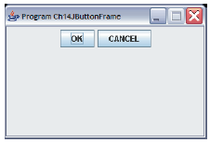
Container as Event Listener
Instead of defining a separate event listener such as ButtonHandler, it is much more common to have an object that contains the event sources be a listener.
  Example: We make this frame a listener of the action events of the buttons it contains.
event listener
event source
Notes:
Because ActionListener is a Java interface and not a class, action event listener objects are not limited to instances of fixed classes. Any class can implement the ActionListener interface, so any object from a class that implements this interface can be an action event listener. This adds flexibility as this example illustrates.
Instead of using a ButtonHandler object, we can make the frame object itself to be an action event listener.

Slide 51
GUI Classes for Handling Text
The Swing GUI classes JLabel, JTextField, and JTextArea deal with text.
A JLabel object displays uneditable text (or image).
A JTextField object allows the user to enter a single line of text.
A JTextArea object allows the user to enter multiple lines of text. It can also be used for displaying multiple lines of uneditable text.
Notes:
Notice that JLabel objects are not limited to text. Using them is actually the easiest and quickest way to display an image. JTextArea has dual pursposes. It can be used to display noneditable multi-line text, similar to using multiple JLabel objects. It can also be used to allow the user to enter multiple lines of text, similar to using multiple JTextField objects.

Slide 52
JTextField
We use a JTextField object to accept a single line to text from a user. An action event is generated when the user presses the ENTER key.
The getText method of JTextField is used to retrieve the text that the user entered.
JTextField input = new JTextField( );
input.addActionListener(eventListener);
contentPane.add(input);
Notes:
The getText method is most commonly used inside the actionPerformed method of an action listener.

Slide 53
JLabel
We use a JLabel object to display a label.
A label can be a text or an image.
When creating an image label, we pass ImageIcon object instead of a string.
JLabel textLabel = new JLabel("Please enter your name");
contentPane.add(textLabel);
JLabel imgLabel = new JLabel(new ImageIcon("cat.gif"));
contentPane.add(imgLabel);
Notes:
A JLabel is strictly for displaying noneditable text or image. A JLabel object does not generate any events.

Slide 54
JPasswordField
allows the editing of a single line of text where the view indicates something was typed, but does not show the original characters.
JPasswordField passwordLine = new JPasswordField();
passwordLine.setBounds(90,110,130,25);
contentPane.add(passwordLine);

Slide 55
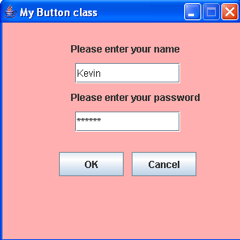
Example – Let’s make this frame
Notes:
The sample Ch7TextFrame2 class includes five GUI components: two JLabel objects, one JTextField object, and two JButton objects.

Slide 56
JTextArea
We use a JTextArea object to display or allow the user to enter multiple lines of text.
The setText method assigns the text to a JTextArea, replacing the current content.
The append method appends the text to the current text.
JTextArea textArea
= new JTextArea( );
. . .
textArea.setText("Hello\n");
textArea.append("the lost ");
textArea.append("world");
Hello
the lost world
JTextArea
Notes:
Notice how the append method works. If you want to place the text to be appended on a new line, you have ouput the newline control character \n at the appropriate point.

Slide 57
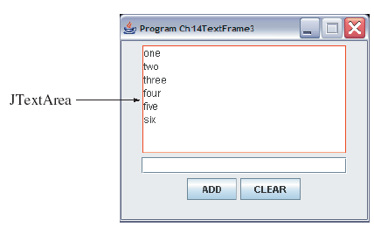
Let’s modify our example to add this
Notes:
Run the program and explore it. This frame has one JTextField object and one JTextArea object. Every time a text is entered in the text field and the ENTER key is pressed or the ADD button is clicked, the entered text is append to the text area. The border of red color is adorned to the text area to demarcate the region.

Slide 58
Adding Scroll Bars to JTextArea
By default a JTextArea does not have any scroll bars. To add scroll bars, we place a JTextArea in a JScrollPane object.
JTextArea textArea = new JTextArea();
. . .
JScrollPane scrollText = new JScrollPane(textArea);
. . .
contentPane.add(scrollText);
Notes:
Here's a sample to wrap the text area with scroll bars.

Slide 59
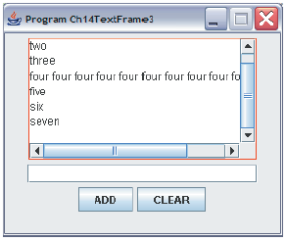
TextArea with Scroll Bars
Notes:
Initially, there will be no scroll bars. Run the program and confirm this behavior. When the displayed text goes beyond the horizontal or vertical boundary, the corresponding scroll bar appears.

Slide 60
Placing GUI Objects on a Frame
There are two ways to put GUI objects on the content pane of a frame:
  Use a layout manager
    FlowLayout
    BorderLayout
    GridLayout
  Use absolute positioning
    null layout manager
Notes:
The content pane of a frame is where we can place GUI components. Among the approaches available to us to place components, we will study the easier one here. The easier absolute positioning is not a recommended approach for practical applications, but our objective here is to learn the basic handling of events and placement of GUI objects, we will use the easier approach. Chapter 12 of the textbook discusses different layout managers.

Slide 61
Layout Managers
The layout manager determines how the GUI components are added to the container (such as the content pane of a frame)
Among the many different layout managers, the common ones are
  FlowLayout
  BorderLayout
  GridLayout

Slide 62
FlowLayout
In using this layout, GUI component share placed in left-to-right order.
  When the component does not fit on the same line, left-to-right placement continues on the next line.
As a default, components on each line are centered.
When the frame containing the component is resized, the placement of components is adjusted accordingly.

Slide 63
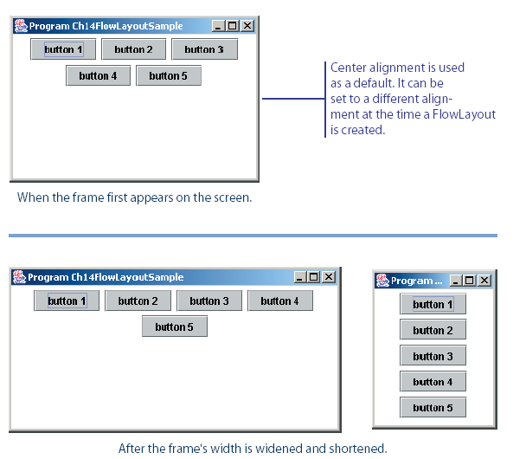
FlowLayout Sample
This shows the placement of five buttons by using FlowLayout.

Slide 64
BorderLayout
This layout manager divides the container into five regions: center, north, south, east, and west.
The north and south regions expand or shrink in height only
The east and west regions expand or shrink in width only
The center region expands or shrinks on both height and width.
Not all regions have to be occupied.

Slide 65
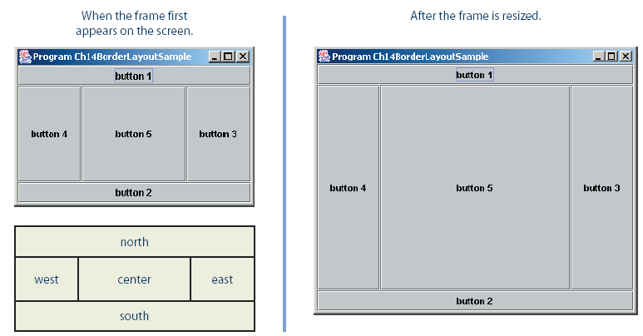
BorderLayout Sample
Notes:
contentPane.setLayout(new BorderLayout());
contentPane.add(button1, BorderLayout.NORTH);
contentPane.add(button2, BorderLayout.SOUTH);
contentPane.add(button3, BorderLayout.EAST);
contentPane.add(button4, BorderLayout.WEST);
contentPane.add(button5, BorderLayout.CENTER);

Slide 66
GridLayout
This layout manager placesGUI components on equal-size N by M grids.
Components are placed in top-to-bottom, left-to-right order.
The number of rows and columns remains the same after the frame is resized, but the width and height of each region will change.

Slide 67
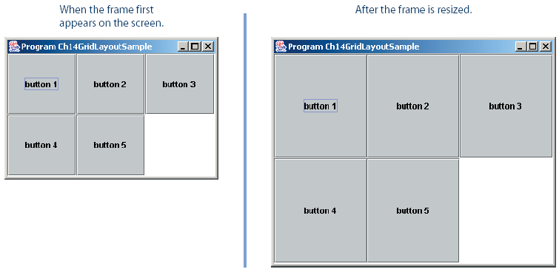
GridLayout Sample

Slide 68
Nesting Panels
It is possible, but very difficult, to place all GUI components on a single JPanel or other types of containers.
A better approach is to use multiple panels, placing panels inside other panels.

Slide 69
JButton
Button
  Component user clicks to trigger a specific action
  Can be command button, check box, toggle button or radio button
  Button types are subclasses of class AbstractButton

Slide 70
JButton
JButtons can have a rollover icon
  Appears when mouse is positioned over a button
  Added to a JButton with method setRolloverIcon

Slide 71
Buttons That Maintain State
State buttons
  Swing contains three types of state buttons
  JToggleButton, JCheckBox and JRadioButton
  JCheckBox and JRadioButton are subclasses of JToggleButton

Slide 72
JCheckBox
JCheckBox
  Contains a check box label that appears to right of check box by default
  Generates an ItemEvent when it is clicked
    ItemEvents are handled by an ItemListener
    Passed to method itemStateChanged
  Method isSelected returns whether check box is selected (true) or not (false)

Slide 73
JCheckBox
JCheckBox
JCheckBox boldJCheckBox;
JCheckBox italicJCheckBox;
boldJCheckBox = new JCheckBox( "Bold" );
italicJCheckBox = new JCheckBox( "Italic" );

Slide 74
JRadioButton
JRadioButton
  Has two states – selected and unselected
  Normally appear in a group in which only one radio button can be selected at once
    Group maintained by a ButtonGroup object
      Declares method add to add a JRadioButton to group
  Usually represents mutually exclusive options

Slide 75
JRadioButton
JRadioButton plainJRadioButton;
JRadioButton boldJRadioButton;
ButtonGroup radioGroup;
plainJRadioButton=new JRadioButton( "Plain", true );
boldJRadioButton=new JRadioButton( "Bold", false );
radioGroup = new ButtonGroup();
radioGroup.add( plainJRadioButton );
radioGroup.add( boldJRadioButton );

Slide 76
JComboBox and Using an Anonymous Inner Class for Event Handling
Combo box
  Also called a drop-down list
  Implemented by class JComboBox
  Each item in the list has an index
  setMaximumRowCount sets the maximum number of rows shown at once
  JComboBox provides a scrollbar and up and down arrows to traverse list

Slide 77
JList
List
  Displays a series of items from which the user may select one or more items
  Implemented by class JList
  Allows for single-selection lists or multiple-selection lists
  A ListSelectionEvent occurs when an item is selected
    Handled by a ListSelectionListener and passed to method valueChanged

Slide 78
Multiple-Selection Lists
Multiple-selection list
  Enables users to select many items
  Single interval selection allows only a continuous range of items
  Multiple interval selection allows any set of elements to be selected

Slide 79
Menus
The javax.swing package contains three menu-related classes: JMenuBar, JMenu, and JMenuItem.
JMenuBar is a bar where the menus are placed. There is one menu bar per frame.
JMenu (such as File or Edit) is a group of menu choices. JMenuBar may include many JMenu objects.
JMenuItem (such as Copy, Cut, or Paste) is an individual menu choice in a JMenu object.
Only the JMenuItem objects generate events.
Notes:
Almost all nontrivial GUI programs support menus. By using these three menu-related classes, we can easily add menus to our Java programs.

Slide 80
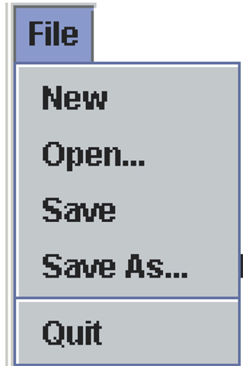
Menu Components
Edit
View
Help
JMenuBar
File
Edit
View
Help
JMenu
JMenuItem
separator
Notes:
The diagram shows how the menu-related objects correspond to the actual menus.

Slide 81
Sequence for Creating Menus
Create a JMenuBar object and attach it to a frame.
Create a JMenu object.
Create JMenuItem objects and add them to the JMenu object.
Attach the JMenu object to the JMenuBar object.
Notes:
This is not the only valid sequence. Other sequences are possible. We list this sequence as one possible sequence you can follow in creating menus.

Slide 82
Handling Mouse Events
Mouse events include such user interactions as
  moving the mouse
  dragging the mouse (moving the mouse while the mouse button is being pressed)
  clicking the mouse buttons.
The MouseListener interface handles mouse button
  mouseClicked, mouseEntered, mouseExited, mousePressed, and mouseReleased
The MouseMotionListener interface handles mouse movement
  mouseDragged and mouseMoved.

Slide 83
Multiple choices review - Inheritance
If a variable is declared as protected, then
A. only the methods in the same class can access the variable.
B. no method can change the value of the variable.
C. any method anywhere can change the value of the variable.
D. any method within a subclass can access the variable.

Slide 84

Multiple choices review - Inheritance
If a variable is declared as protected, then
A. only the methods in the same class can access the variable.
B. no method can change the value of the variable.
C. any method anywhere can change the value of the variable.
D. any method within a subclass can access the variable.

Slide 85
Inheritance overview
Which of the following is not a superclass/subclass relationship?
a. Ford/Taurus.
b. University/Brown University.
c. Cat/Dog.
d. Country/USA.

Slide 86
Inheritance overview
Which of the following is not a superclass/subclass relationship?
a. Ford/Taurus.
b. University/Brown University.
c. Cat/Dog.
d. Country/USA.

Slide 87
Inheritance overview
An advantage of inheritance is that:
a. All methods can be inherited.
b. All instance variables can be uniformly accessed by subclasses and superclasses.
c. Objects of a subclass can be treated like objects of their superclass.
d. None of the above.

Slide 88
Inheritance overview
An advantage of inheritance is that:
a. All methods can be inherited.
b. All instance variables can be uniformly accessed by subclasses and superclasses.
c. Objects of a subclass can be treated like objects of their superclass.
d. None of the above.

Slide 89
Inheritance overview
Superclass methods with this level of access cannot be called from subclasses.
a. private.
b. public.
c. protected.
d. package.

Slide 90
Inheritance overview
Superclass methods with this level of access cannot be called from subclasses.
a. private.
b. public.
c. protected.
d. package.

Slide 91
Inheritance
Which of the following is the superclass constructor call syntax?
a. keyword super, followed by a set of parentheses.
b. keyword super, followed by a dot (.) .
c. keyword super, followed by a set of parentheses containing the superclass constructor arguments.
d. keyword super, followed by a dot and the superclass constructor name.

Slide 92
Inheritance
Which of the following is the superclass constructor call syntax?
a. keyword super, followed by a set of parentheses.
b. keyword super, followed by a dot (.) .
c. keyword super, followed by a set of parentheses containing the superclass constructor arguments.
d. keyword super, followed by a dot and the superclass constructor name.

